Slide 1
DEEP LEARNING
Akshay V R
eng19cs0023

Slide 2
Deep Neural Networks
An artificial network consists of a pool of simple processing units which communicate by sending signals to each other over a large number of weighted connections. Many Neural networks together forms DNN.
It mainly has dense layers which consists of input, output and dense neurons.

Slide 3
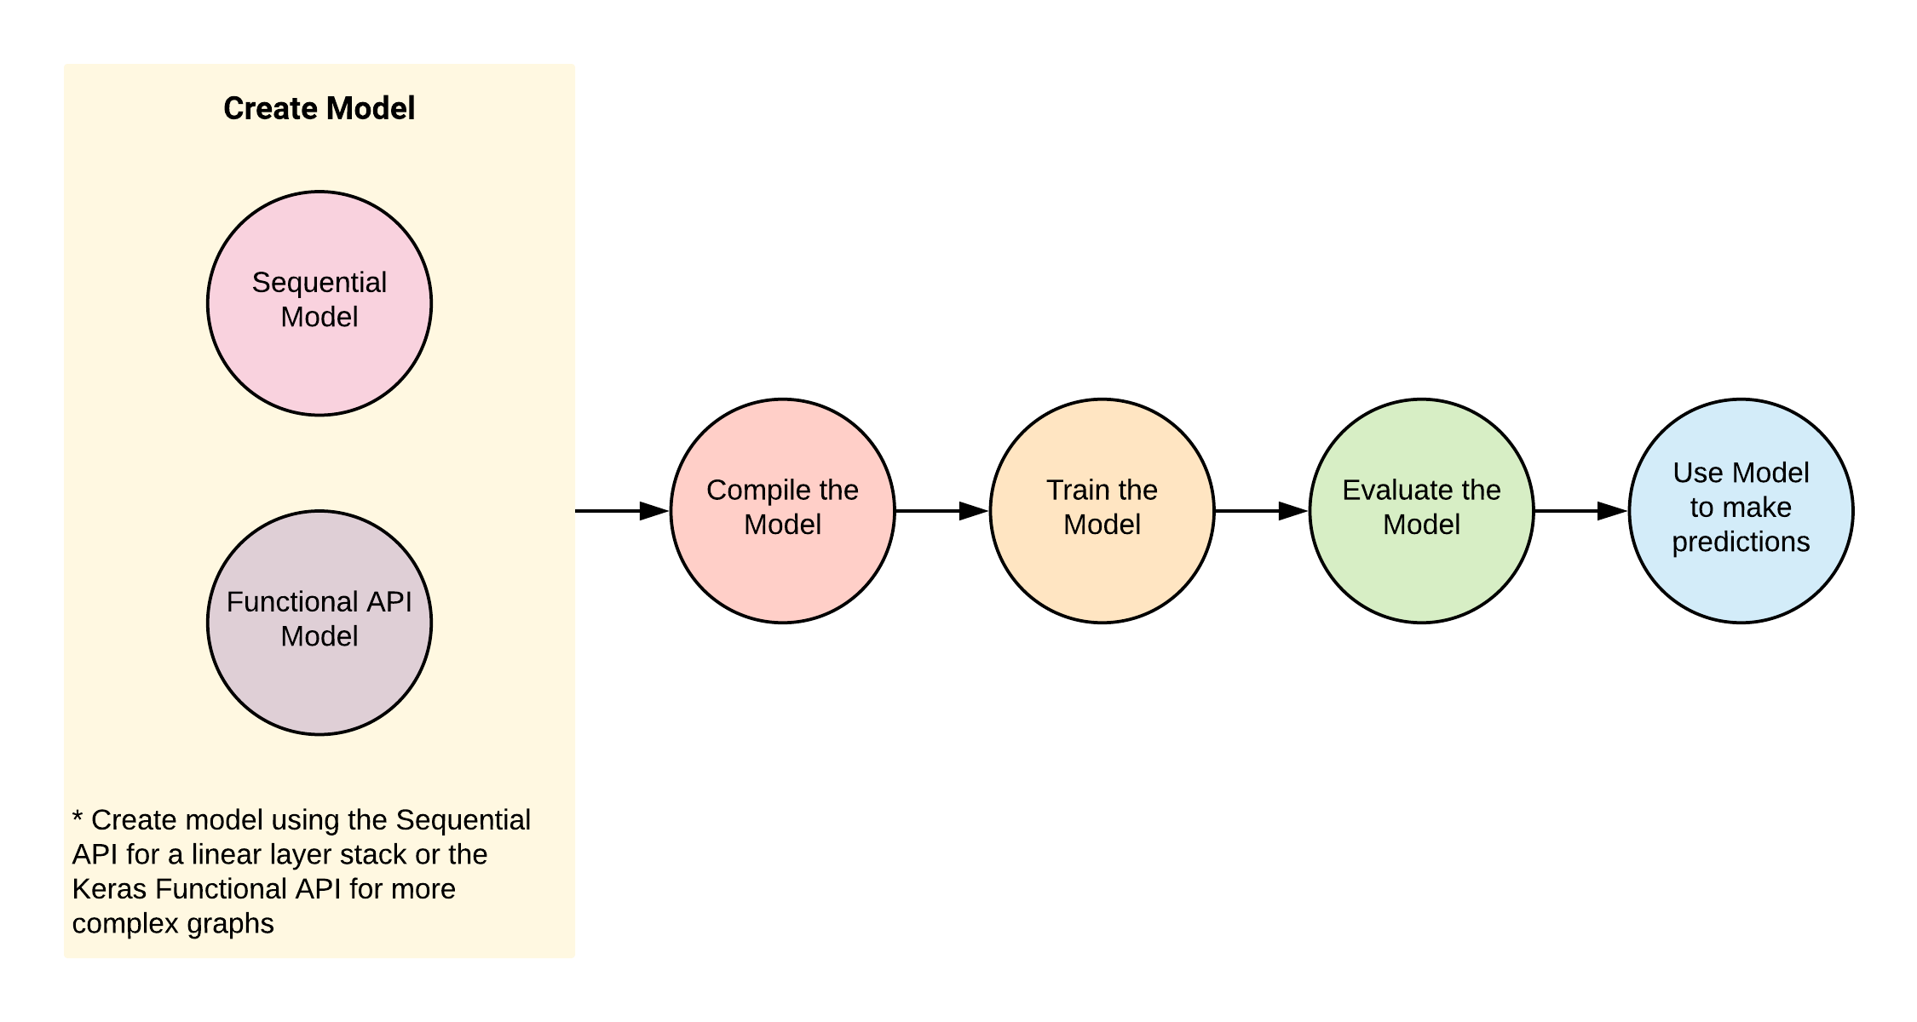
Deep Neural Networks

Slide 4
Forward feedback backward propagation loss function
Feed-forward neural networks take in a fixed amount of input data all at the same time and produce a fixed amount of output each time.It is used for more accuracy purpose.
Backward propagation - Is used to get more accuracy from DNN networks .
It is said to be done when one epoch is completed.
Loss function -Is a component of DNN(neural network), which is for the prediction of the error and to try to reduce the error as much as possible.
All these together makes DNN to be more accurate .

Slide 5
FORWARD PROPAGATION
Following are the steps performed during the feed-forward phase:
The values received in the input layer are multiplied with the weights. A bias is added to the summation of the inputs and weights in order to avoid null values.
Each neuron in the first hidden layer receives different values from the input layer depending upon the weights and bias. Neurons have an activation function that operates upon the value received from the input layer. The activation function can be of many types, like a step function, sigmoid function, relu function, or tanh function. As a rule of thumb, relu function is used in the hidden layer neurons and sigmoid function is used for the output layer neuron.
The outputs from the first hidden layer neurons are multiplied with the weights of the second hidden layer; the results are summed together and passed to the neurons of the proceeding layers. This process continues until the outer layer is reached. The values calculated at the outer layer are the actual outputs of the algorithm.
The feed-forward phase consists of these three steps. However, the predicted output is not necessarily correct right away; it can be wrong, and we need to correct it. The purpose of a learning algorithm is to make predictions that are as accurate as possible. To improve these predicted results, a neural network will then go through a back propagation phase. During back propagation, the weights of different neurons are updated in a way that the difference between the desired and predicted output is as small as possible.

Slide 6
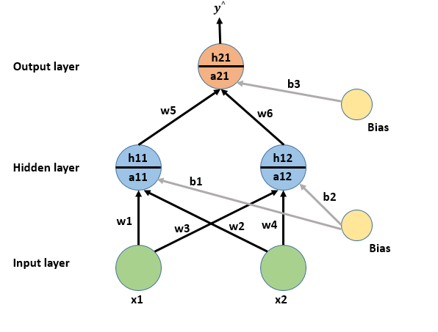

Slide 7
BACKWARD PROPAGATION
Back propagation phase consists of the following steps:
The error is calculated by quantifying the difference between the predicted output and the desired output. This difference is called "loss" and the function used to calculate the difference is called the "loss function". Loss functions can be of different types e.g. mean squared error or cross entropy functions. Remember, neural networks are supervised learning algorithms that need the desired outputs for a given set of inputs, which is what allows it to learn from the data.
Once the error is calculated, the next step is to minimize that error. To do so, partial derivative of the error function is calculated with respect to all the weights and biases. This is called gradient decent. The derivatives can be used to find the slope of the error function. If the slop is positive, the value of the weights can be reduced or if the slop is negative the value of weight can be increased. This reduces the overall error. The function that is used to reduce this error is called the optimization function.
This one cycle of feed-forward and back propagation is called one "epoch". This process continues until a reasonable accuracy is achieved. There is no standard for reasonable accuracy, ideally you'd strive for 100% accuracy, but this is extremely difficult to achieve for any non-trivial dataset. In many cases 90%+ accuracy is considered acceptable, but it really depends on your use-case.

Slide 8
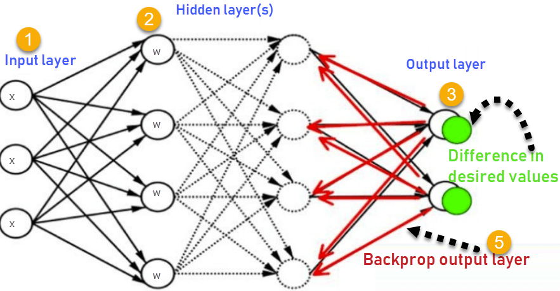
BACKWARD PROPAGATION
Fig. Backward Propagation in Neural Network

Slide 9
METRICS
A metric is a function that is used to judge the performance of your model.
Metric functions are similar to loss functions, except that the results from evaluating a metric are not used when training the model. Note that you may use any loss function as a metric.
Metrics are used to monitor and measure the performance of a model (during training and testing), and don’t need to be differentiable.
However, if for some tasks the performance metric is differentiable, it can also be used as a loss function (perhaps with some regularizations added to it), such as MSE.

Slide 10
Transfer functions
Sigmoid – is used in DNN for classification purpose . It is used in the output layer. It is used in activation parameter.
Relu – is used in DNN for regression purpose. It is used in input as well as in output layer. It is used in activation parameter.
Tanh – is used very similar to the sigmoid function and is used for classification purpose.

Slide 11
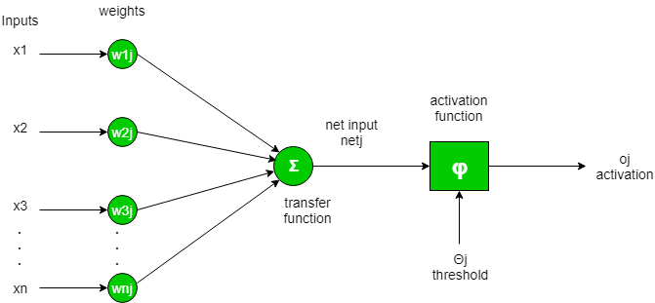
TRANSFER FUNCTIONS
It is used to determine the output of neural network like yes or no. It maps the resulting values in between 0 to 1 or -1 to 1 etc (depending upon the function). It is also known as Activation Functions.
The Activation Functions can be basically divided into 2 types-
Linear Activation Function
Non-linear Activation Functions
Generally, neural networks use non-linear activation functions, which can help the network learn complex data, compute and learn almost any function representing a question, and provide accurate predictions. They allow back-propagation because they have a derivative function which is related to the inputs.

Slide 12
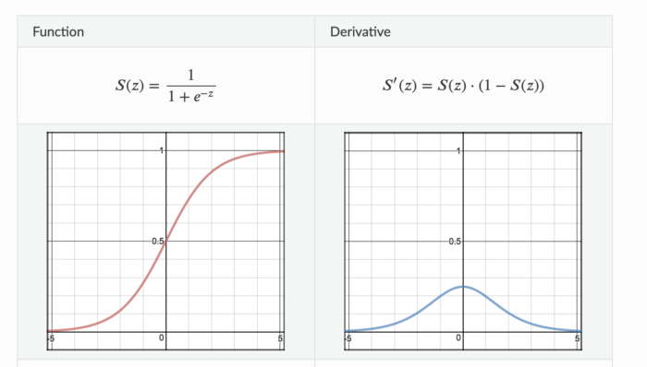
1. Sigmoid Activation Function:
Sigmoid Activation function is very simple which takes a real value as input and gives probability that ‘s always between 0 or 1. It looks like ‘S’ shape.
It’s non-linear, continuously differentiable, monotonic, and has a fixed output range. Main advantage is simple and good for classifier. But big disadvantage of the function is that it gives rise to a problem of “vanishing gradients” because Its output isn’t zero centered. It makes the gradient updates go too far in different directions. 0 < output < 1, and it makes optimization harder. That takes very high computational time in hidden layer of neural network.

Slide 13
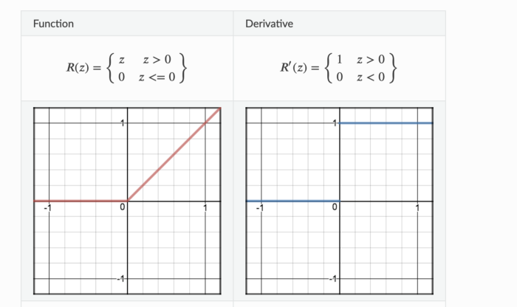
2. ReLU (Rectified Linear Unit):
This is most popular activation function which is used in hidden layer of Neural Network. The formula is deceptively simple: 𝑚𝑎𝑥(0,𝑧)max(0,z). Despite its name and appearance, it’s not linear and provides the same benefits as Sigmoid but with better performance.
It’s main advantage is that it avoids and rectifies vanishing gradient problem and less computationally expensive than tanh and sigmoid. But it also has some draw back. Sometime some gradients can be fragile during training and can die. That leads to dead neurons. In other words, for activations in the region (x<0) of ReLu, gradient will be 0 because of which the weights will not get adjusted during descent. That means, those neurons which go into that state will stop responding to variations in error/ input ( simply because gradient is 0, nothing changes ). So We should be very careful to choose activation function , and activation function should be as per business requirement.

Slide 14
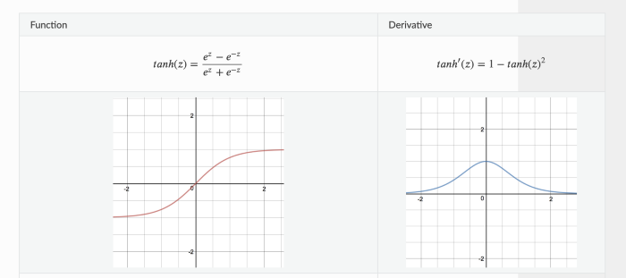
3. Tanh or Hyperbolic tangent:
Tanh helps to solve non zero centered problem of sigmoid function. Tanh squashes a real-valued number to the range [-1, 1].
Derivative function gives us almost same as sigmoid’s derivative function.
It solves sigmoid’s drawback but it still can’t remove the vanishing gradient problem completely.

Slide 15
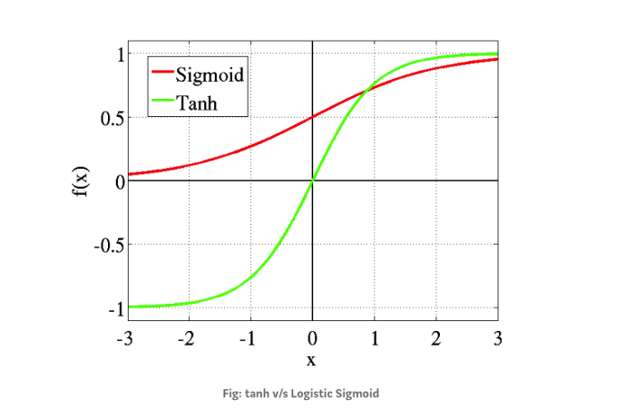
When we compare tanh activation function with sighmoid , this picture give you clear idea.

Slide 16
Overfit underfit and optimal fit
Overfit – is when the errors are least in DNN but it is very complicated as all the points must be connected in the graph.
Underfit - is when the errors are most in DNN but it is very simple as all the points need not be connected in the graph.
Optimal fit – is when there are average errors in DNN but a mathematical equation can be produced by connecting few of the points.

Slide 17
Reference
Collab- https://colab.research.google.com/drive/1eJz7yuHTW_nqvSJbR-y_5-z1UwEBP-9c
GitHub- https://github.com/ENG19CS0023-AKSHAY/Deep-learning

Slide 18
Thank you

